Slide 1
CSAF Standards and OpenEuler Practices

Slide 2
Content
Introduction to the CSAF Standard
OpenEuler CSAF Practice and Progress
Next step for OpenEuler on CSAF

Slide 3
Introduction to the CSAF Standard

Slide 4



What is CSAF?
Common Security Advisory Framework
Machine-readable format for security advisories (JSON)
Standardized way of distribution security advisories
Build with automation in mind
Standardized tool set
Guidance to actionable information
Successor of CSAF CVRF 1.2

Slide 5
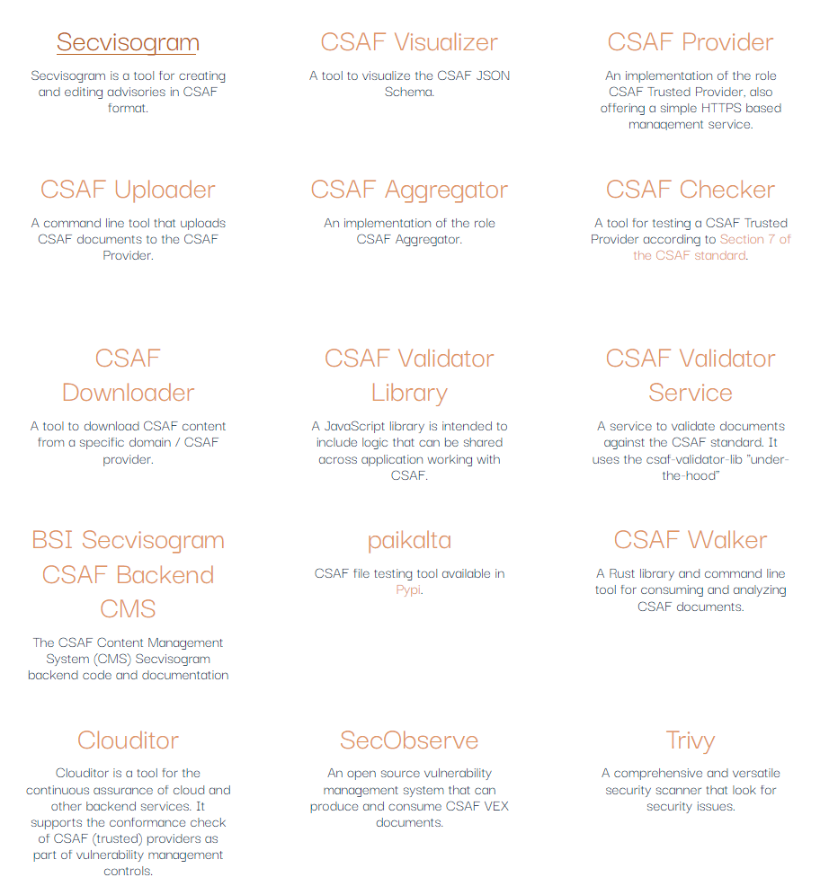





Automated process with CSAF and tooling ecosystem
CSAF Process Automation
CSAF Open Source Tool Ecosystem
1
Vendor / Supplier
Creates and shares CSAF documents.
2
User
Looks for new advisories and downloads them.
3
User
Evaluates affected products and priority.
4
User
Sorts by priority and decides actions.
Less human intervention in the process
Scalable approach across all vendors / suppliers
Machine-readable asset inventory
https://oasis-open.github.io/csaf-documentation/tools.html

Slide 6
Where to find CSAF documents?
https://docs.oasis-open.org/csaf/csaf/v2.0/os/csaf-v2.0-os.html#7-distributing-csaf-documents
Sign own advisories Hash advisories Published PGP keys for integrity checks All requirements from CSAF provider | CSAF Trusted provider
Well-defined URL / security.txt / DNS=> provider-metadata.json List of advisories and latest changes and Fixed folder structure (or ROLIE feeds) Restriction on >=TLP:AMBER All requirements from CSAF publisher | CSAF Provider
Valid CSAF documents File name restrictions TLS enforced TLP:WHITE freely accessible | CSAF Publisher
Capabilities and Trust level

Slide 7
CSAF Profiles
Profile 1: CSAF Base
Default required fields for any CSAF document. Foundation for the other profiles to build on.
Profile 2: Security Incident Response
Used to provide a response to a security breach or incident. This could be related or unrelated to using party’s own offerings/infrastructure.
Profile 3: Informational Advisory
Profile 4: Security Advisory
Used to provide information which is related to vulnerabilities and remediations
Profile 5: Vulnerability Exploitability Exchange (VEX)
Used to provide VEX information. State why a product is – or is not – affected by a vulnerability.
Used to provide information not related to a vulnerability (i.e. commonly observed misconfigurations)
CSAF documents do not have many required fields as they can be used for different purposes
The CSAF 2.0 standard defines profiles to ensure a common understanding which fields are required in a use case.

Slide 8



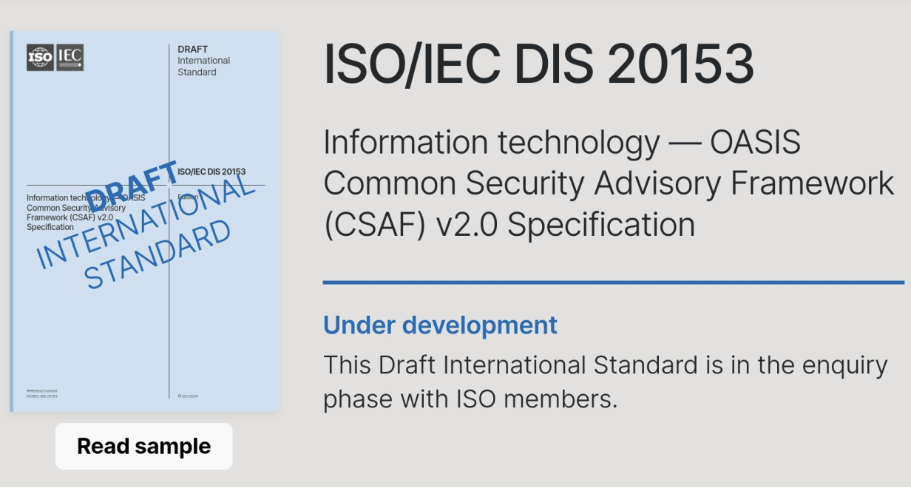

Roadmap for CSAF: Further International Standardization and New Capabilities
Feature Development
Further International Standardization
• CSAF 2.1: Maintenance, capability and usability improvements (incl support for CVSS v4, TLPv2, “sharing_groups” etc)
• Current Status: In development. CSAF 2.1 Committee Specification expected Dec 2024.
• CSAF 3.0: New advanced capabilities (such as standardization of CSAF APIs)
• Current Status: In development CSAF 3.0 Committee Specification expected during 2025.
• OASIS is an approved ISO/IEC JTC 1 PAS submitter, meeting criteria for international standards submissions. • Current Status: CSAF submission is to be sent to national bodies for balloting for voting and review. • Goal: If approved, CSAF will become an ISO/IEC international standard. • Timeline: Results at the end of 2024 (expectation – not confirmed)

Slide 9
OpenEuler CSAF Practice and Progress

Slide 10
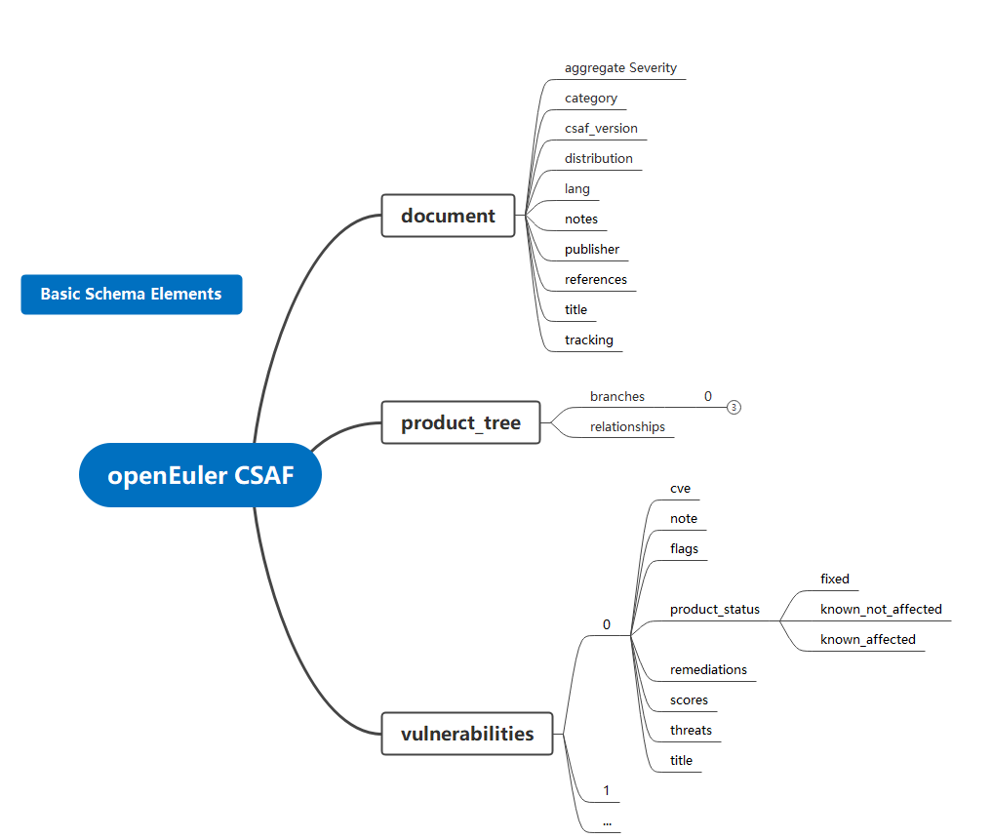
OpenEuler Disclosure of CSAF Files
1. Security bulletin dimension: CSAF:
Disclose the security bulletins on the fixed vulnerabilities of openEuler products from the perspective of security bulletins.
2. CVE-based CSAF:
Disclose the impact of each CVE on the openEuler product and the repair status of each CVE from the CVE dimension.
CSAF 2.0 standard reference:
https://docs.oasis-open.org/csaf/csaf/v2.0/os/csaf-v2.0-os.html
Creating a Release Review
Collecting CVE and BUGFIX
Baseline confirmation
Check the version.
Import test warehouse
Generate CSAF
Sbom scanning
RPM signature verification
Vulnerability scanning
Virus scanning
Online review
Releasing software packages
To issue a public announcement
Record Archiving
OpenEuler Update Release Process

Slide 11
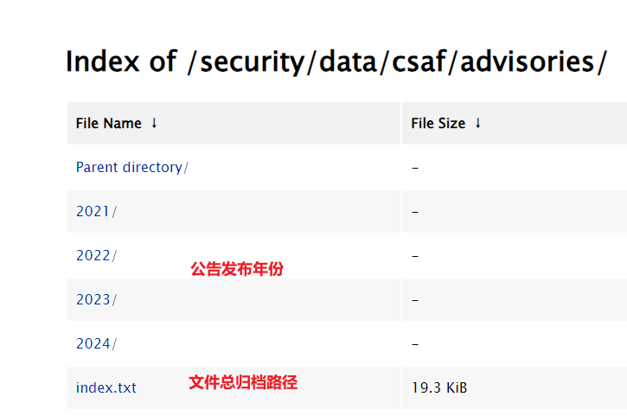
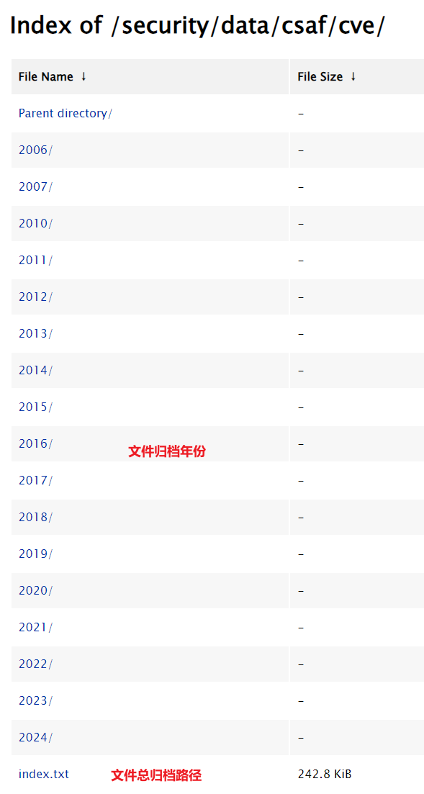
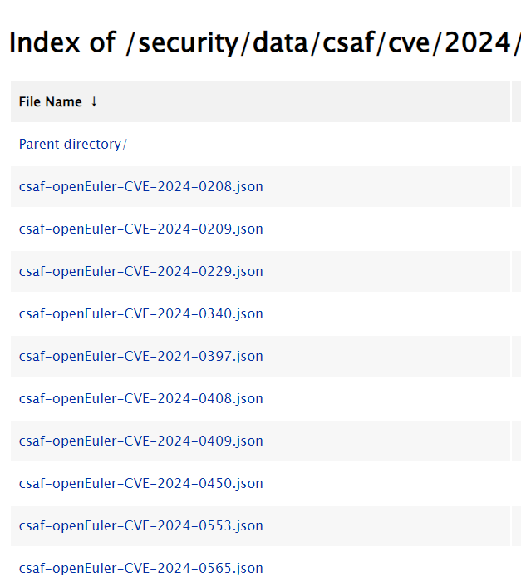
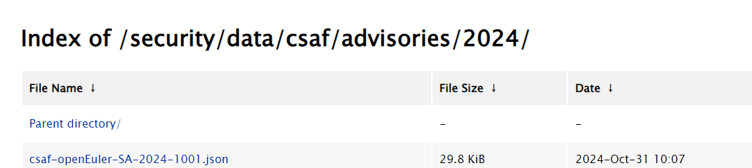
CSAF file archive directory of openEuler
Security bulletin dimension: CSAF
Build a mapping of fixed vulnerabilities for a given product
Archive path:
https://repo.openeuler.org/security/data/csaf/advisories/
CSAF by CVE dimension
Contains product impact information for each vulnerability, supplementing the mapping of unfixed vulnerabilities in a given product
Archive path:
https://repo.openeuler.org/security/data/csaf/cve/
Example
Example
Year of release
Archive Path
Year of release
Archive Path

Slide 12
Next step for OpenEuler on CSAF

Slide 13
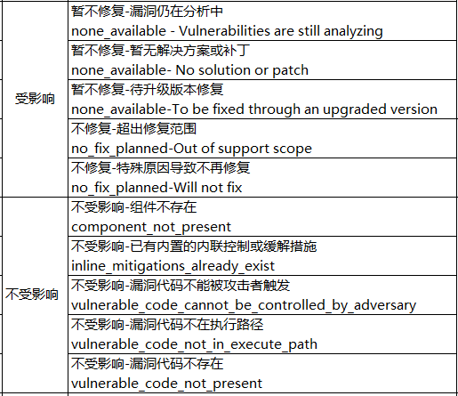
OpenEuler Next Plan
1. The following CVE status is added:
Currently, the openEuler official website supports the disclosure and filtering of CVE statuses fixed, unaffected, and affected,
In the future, the under investigation states will be added.
2. Added the following CVE cause analysis:
Currently, the OpenEuler official website supports filtering for "not fixed - beyond the repair scope" and "not fixed - not fixed for special reasons".
Filtering will be added later.
① Not fixed yet - Vulnerability is still being analyzed
② Not fixed yet - No solution or patch is available.
③ Not fixed (to be fixed in the upgraded version)
④ Not affected - component does not exist
⑤ No Impact - Inline controls or mitigations already built in
⑥ Unaffected - Vulnerable code cannot be triggered by attackers
⑦ Unaffected - Vulnerable code is not in the execution path
⑧ Not Affected - Vulnerability code does not exist
3. Plan to perform CSAF-related adaptation with the vulnerability scanning vendor.

Slide 14
THANKS

